Slide 1
Three Days Workshop On Machine Learning [Day 2]
Organized By:
Association of Computer Engineering Students (ACES)
Eastern Region Campus (ERC), Dharan, Nepal
Instructor:
Manish Bhurtel
AI Engineer at ASMI Corp

Slide 2
CONVOLUTIONAL NEURAL NETWORKS (CNN)
ANN works perfectly for the tabular data but when the thing come to the Image data, things are little bit complex.
We need to extract only the useful features from the image dataset. So in that case Convolutional Neural Networks come into action.
CNN is the network of convolution layers, pooling layers, flattening layers followed by the Artificial Neural Networks.

Slide 3
CONVOLUTIONAL NEURAL NETWORKS (CNN)
Lets understand the Image Dataset:
An image consists of pixels with certain width and height which we term as resolution. E.g.: 480 x 640 pixels
Total pixels = 307200 pixels
Image maybe grayscale (black & white) or colored.
A grayscale image contain pixels with a single channel with the values ranging from 0 – 255
0 referring to Black;
255 referring to white
A colored image contain pixels with 3 channels viz. Red(R), Green(G) and Blue(B)

Slide 4
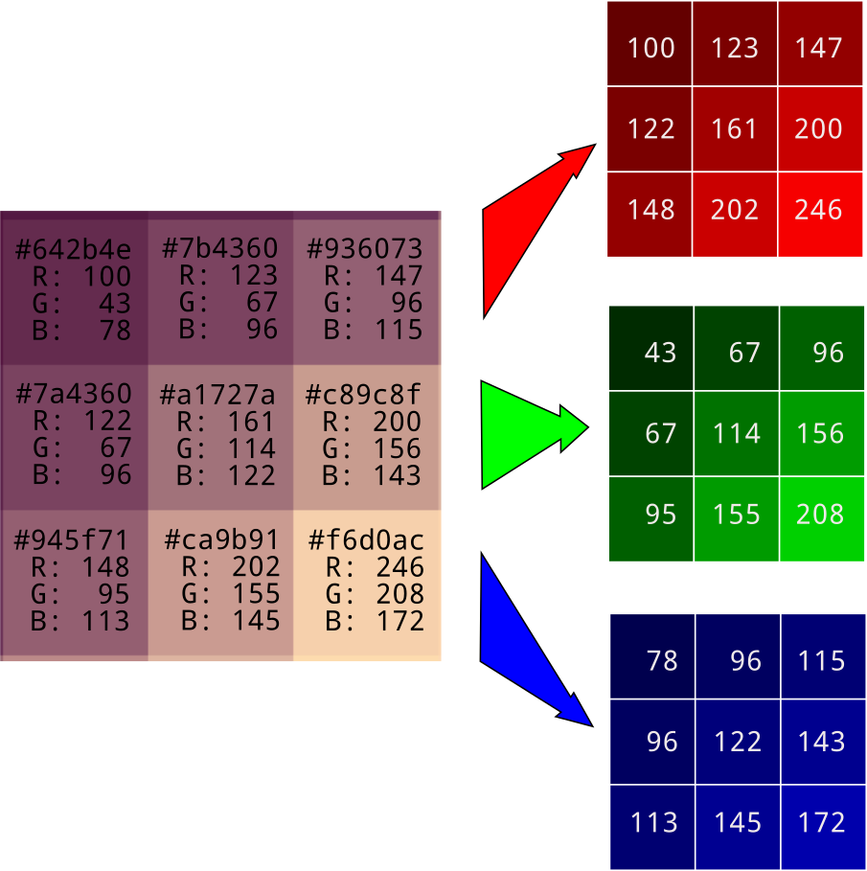
CONVOLUTIONAL NEURAL NETWORKS (CNN)

Slide 5
CONVOLUTIONAL NEURAL NETWORKS (CNN)
BUILDING CNN
Convolution Layer
Pooling Layer
Flattened Layer
Fully Connected Layer

Slide 6
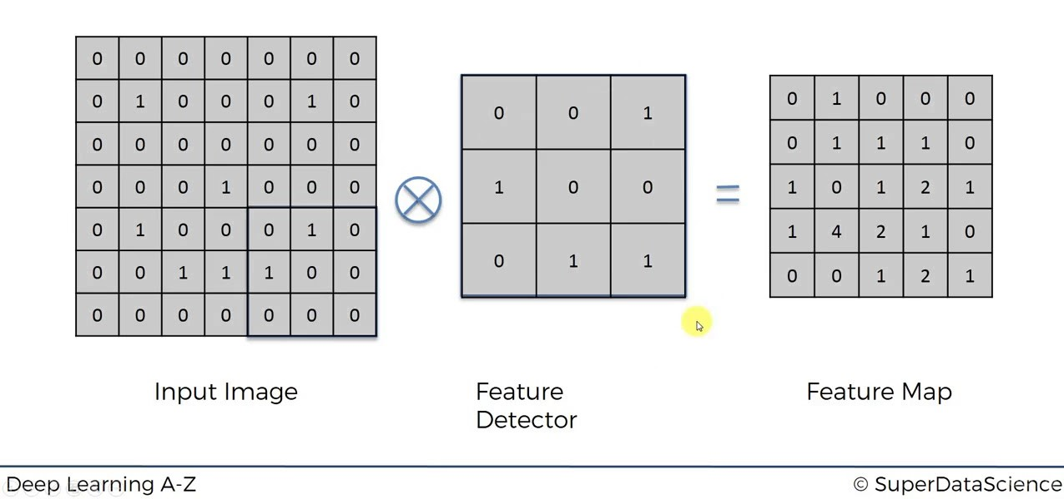
CONVOLUTIONAL NEURAL NETWORKS (CNN)
Stride: Step size, Default: (1,1)
Padding: Valid-> No Zero padding
Same-> With ZP
Default-> Valid
CONVOLUTION LAYER

Slide 7
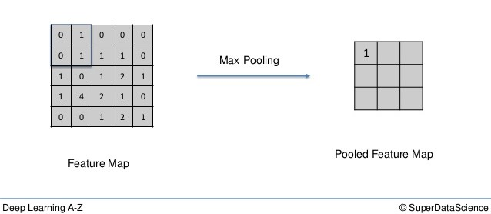
CONVOLUTIONAL NEURAL NETWORKS (CNN)
Pool Size: Size of pool to extract the features
Default: (2,2)
MAX POOL LAYER

Slide 8
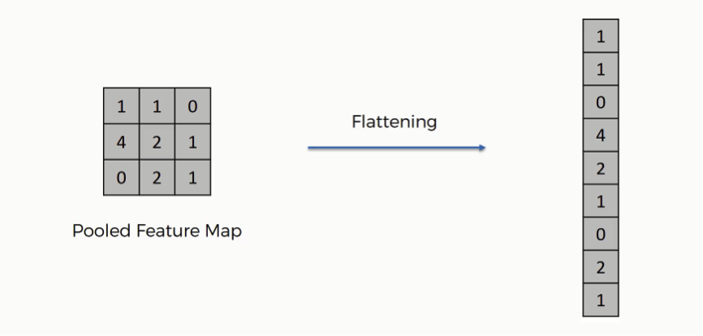
CONVOLUTIONAL NEURAL NETWORKS (CNN)
FLATTENED LAYER
Deep Learning A-Z ©SuperDataScience

Slide 9
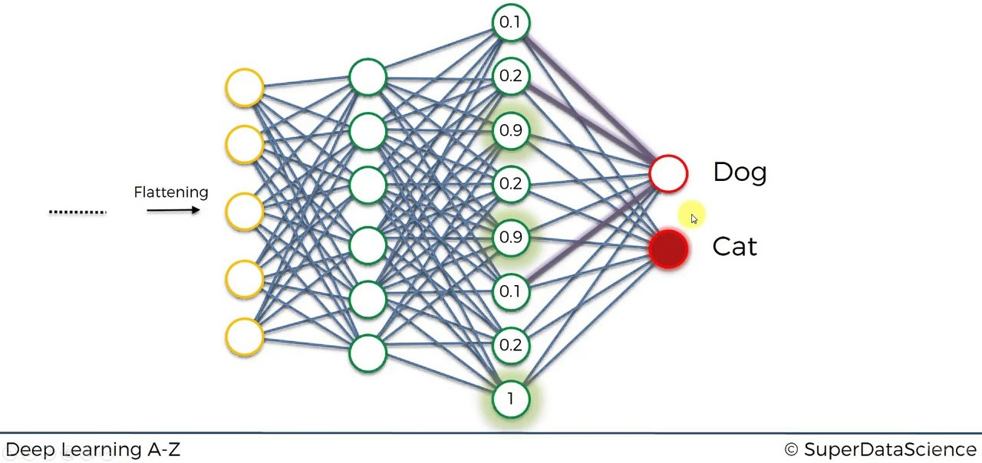
CONVOLUTIONAL NEURAL NETWORKS (CNN)

Slide 10
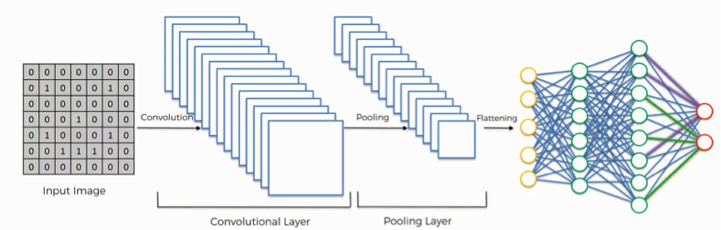
CONVOLUTIONAL NEURAL NETWORKS (CNN)

Slide 11
BACK PROPAGATION
CONVOLUTIONAL NEURAL NETWORKS (CNN)
Similar to ANN, the backpropagation technique to solved all through the Fully Connected Layer (ANN) which traverses to the update of the values in the feature detector.

Slide 12
CONVOLUTIONAL NEURAL NETWORKS (CNN)
Terminologies (we will use in implementation):
Sequential: A model representing a sequence of layers
Conv2D: Convolutional Layer for 2D images
MaxPool2D: Max Pooling Layer for 2D data
Flatten: To shape into a 1D vector
Categorical Data: of the form [1, 0, 0]

Slide 13
CONVOLUTIONAL NEURAL NETWORKS (CNN)
IMPLEMENTATION OF
CNN
USING KERAS

Slide 14
APPLICATIONS OF CNN
CONVOLUTIONAL NEURAL NETWORKS (CNN)
License Plate Recognition
https://www.youtube.com/watch?v=OfYiOK35dyY
Object Detection: YOLO v4
https://www.youtube.com/watch?v=lVdh571SwOQ
Object Segmentation: MaskRCNN
https://www.youtube.com/watch?v=9Z0Eu0HWU2M
Pose Estimation
https://www.youtube.com/watch?v=tdhakdzugU4
Depth Estimation: Self-Driving Cars
https://www.youtube.com/watch?v=KNft4RFsK28&t=82s

Slide 15
Introduction to TensorFlow
TensorFlow is the machine learning framework designed by Google with the sets of tools, libraries and great community support to solve the machine learning problems.
TensorFlow works with the grounds of creating a dataflow graph.
The data flows through different nodes or tensors.
A tensor will represent some computations or operations.
With dataflow graph and tensors, we can perform parallel computing.
So working with TensorFlow involves:
Building the computational graph
Running the computational graph

Slide 16
Nodes/ Tensors in TensorFlow Dataflow Graph
Introduction to TensorFlow
Constant Tensor/ Node:
Node with constant value with defined datatype.
Eg: node1 = tf.constant(5.0, dtype = tf.float32)
Check: print(node1) ???? What does it show?

Slide 17
Nodes/ Tensors in TensorFlow Dataflow Graph
Introduction to TensorFlow
TensorFlow Session
It is used to execute graphs or any part of graphs.
#Starting the session: sess = tensorflow.Session()
#Closing the session: sess.close()
To execute the tensorflow graph, we do not have to run each and every nodes, but just run the final node which is connected to all other nodes.

Slide 18
Nodes/ Tensors in TensorFlow Dataflow Graph
Introduction to TensorFlow
Note: We only have to evaluate the last tensor in the graph. All other associated tensors are evaluated implicitly
TensorFlow Placeholders:
Since constant is static, we can use Placeholders to modify the inputs each time we run the tensor.
TensorFlow placeholders are something that expects some input data.
TF placeholders have 3 arguments:
tf.placehoder(dtype, shape=None, name=name)
dtype = type of data
shape = shape of data that the tensor expects. If not specified, then it accepts any shape of data.
name = name of the operation

Slide 19
Nodes/ Tensors in TensorFlow Dataflow Graph
Introduction to TensorFlow
TensorFlow Variables:
The limitations of placeholder is that, once we pass certain values into the placeholder then it cannot be modified during the execution time.
But TF variables is assigned an initial value and then can be modified during the execution of the program.
TF Variables have to be initialized when created.
tensorflow.Variable(initial_value, dtype)
Note: The main use of TF Variables is to hold Trainable parameters
Since we have to initialize all the variables, we can do it directly by
init = tf.global_variables_initializer()
sess.run(init)

Slide 20
THANK YOU!!!

